Slide 1
2.0 Security
Malware
Social Engineering
Threats

Slide 2
What is the difference between Malware and Virus?
Often used interchangeably, the terms malware and virus have two distinct meanings.
Malware, or malicious software, is a term used to describe any program or code that is created with the intent to do harm to a computer, network or server.
A virus, on the other hand, is a type of malware. Its definition is limited only to programs or code that self-replicates or copies itself in order to spread to other devices or areas of the network.

Slide 3
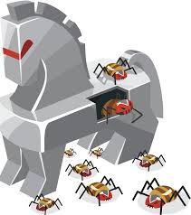
Trojan
Trojan viruses are a type of malware that invade your computer disguised as real, seemingly good, operational programs.

Slide 4
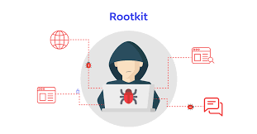
Root Kit
A rootkit is a malicious software bundle designed to give unauthorized access to a computer or other software. Rootkits are hard to detect as they try to get as close to the kernel as possible to elevate their rights and can conceal their presence within an infected system.

Slide 5

Virus
A computer virus is malicious code that replicates by copying itself to another program, computer boot sector or document and changes how a computer works. A virus spreads between systems after some type of human intervention.

Slide 6
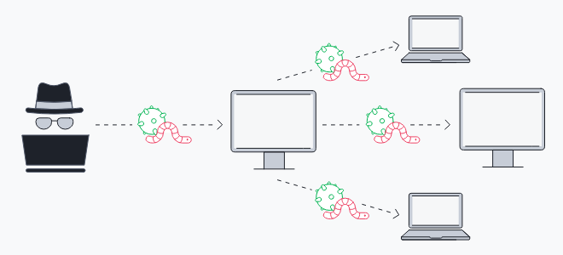
Worm
Worms are similar to virus except that they spread WITHOUT
human intervention.

Slide 7
Spyware
Spyware is any software that installs itself on your computer and starts covertly monitoring your online behavior without your knowledge or permission. Spyware is a kind of malware that secretly gathers information about a person or organization and relays this data to other parties.

Slide 8
Ransomware
Ransomware is a type of malicious software that infects a computer and restricts users' access to it until a ransom is paid to unlock it.

Slide 9
Keylogger
Keyloggers or keystroke loggers are software programs or hardware devices that track the activities (keys pressed) of a keyboard. Keyloggers are a form of spyware where users are unaware their actions are being tracked.

Slide 10
Boot sector virus
A boot sector virus is a type of malware that infects a system’s boot partition or the Master Boot Record (MBR) of a hard disk.

Slide 11
Cryptominers
Cryptomining malware, or 'cryptojacking,' is a malware attack that co-opts the target's computing resources in order to mine cryptocurrencies like bitcoin.
This malware uses a systems CPU and sometimes GPU to perform complex mathematical calculations that result in long alphanumeric strings called hashes.

Slide 12
Preventing Malware
- Recovery mode
- Antivirus
- Anti-malware
- Software firewalls
- Anti-phishing training
- User education regarding common threats
- OS reinstallation

Slide 13
Social Engineering
Phishing
Vishing
Shoulder surfing
Whaling
Tailgating
Impersonation
Dumpster diving
Evil twin

Slide 14
Phishing, Vishing
Phishing is a form of social engineering where attackers deceive people into revealing sensitive information or installing malware such as ransomware
Voice phishing, or vishing, is the use of telephony to conduct phishing attacks.

Slide 15
Shoulder Surfing
Shoulder surfing is a type of social engineering technique used to obtain information such as personal identification numbers, passwords and other confidential data by looking over the victim's shoulder.

Slide 16
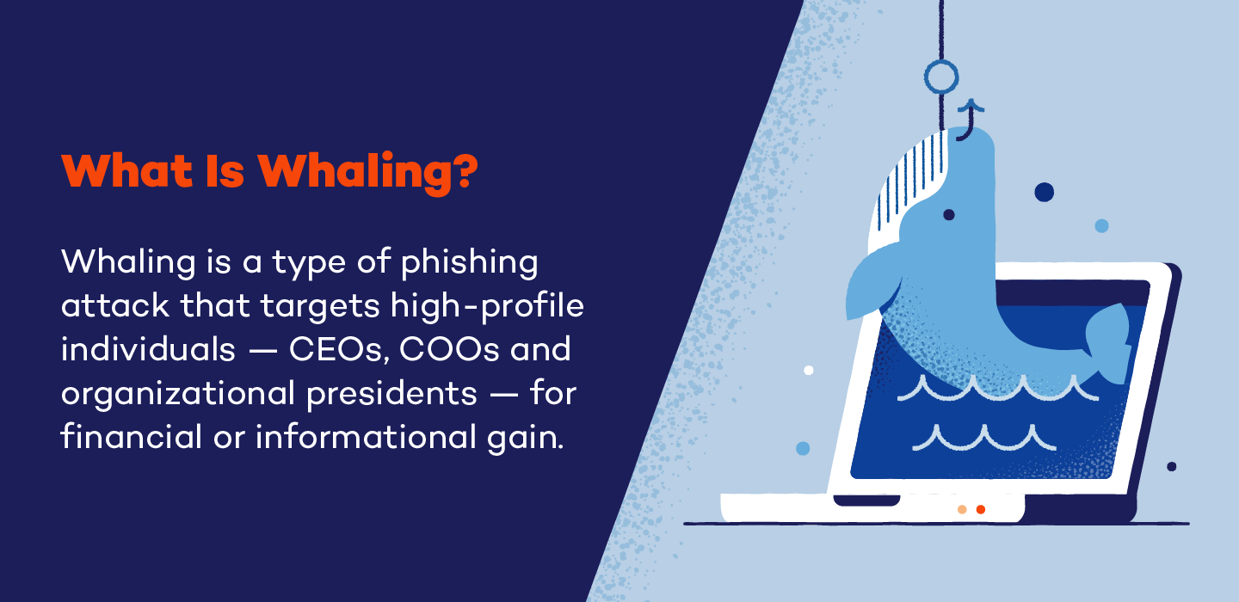
Whaling

Slide 17

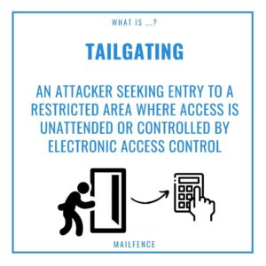
Tailgating

Slide 18
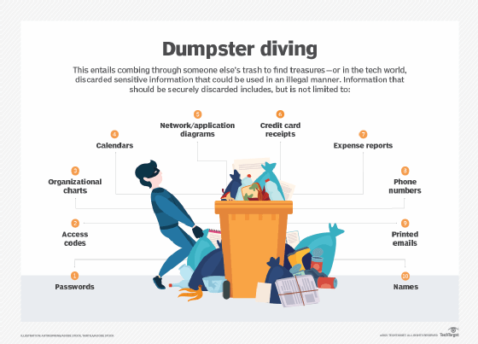
Dumpster diving

Slide 19
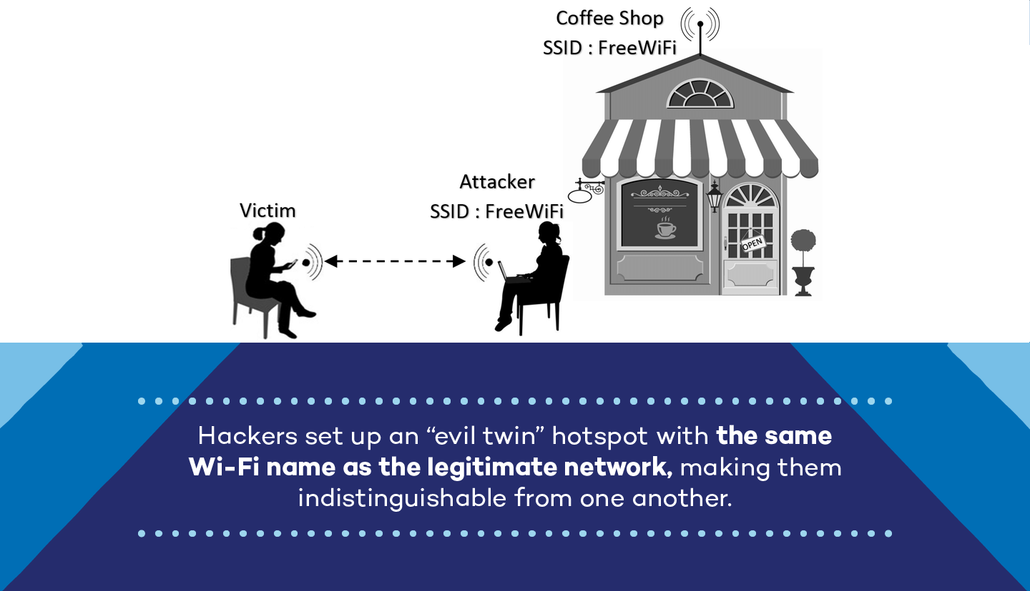
Evil Twin

Slide 20
Threats
- Distributed denial of service (DDoS)
- Denial of service (DoS)
- Zero-day attack
- Spoofing
- On-path attack
- Brute-force attack
- Dictionary attack
- Insider threat
- Structured Query Language (SQL) injection
- Cross-site scripting (XSS)

Slide 21
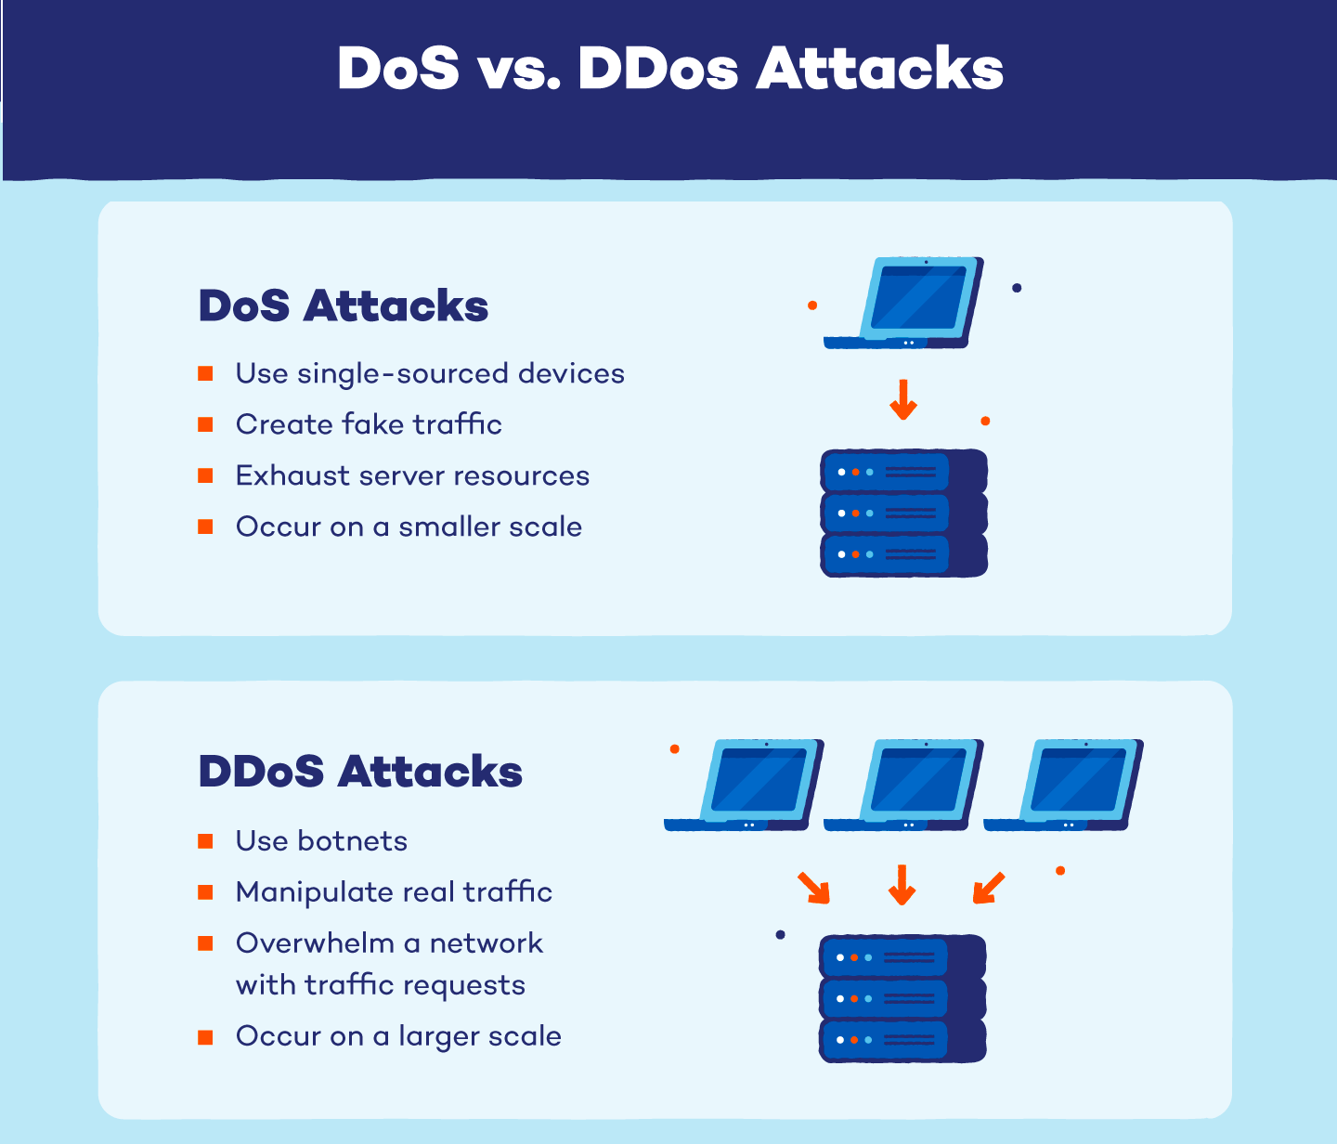
DDoS & DoS

Slide 22
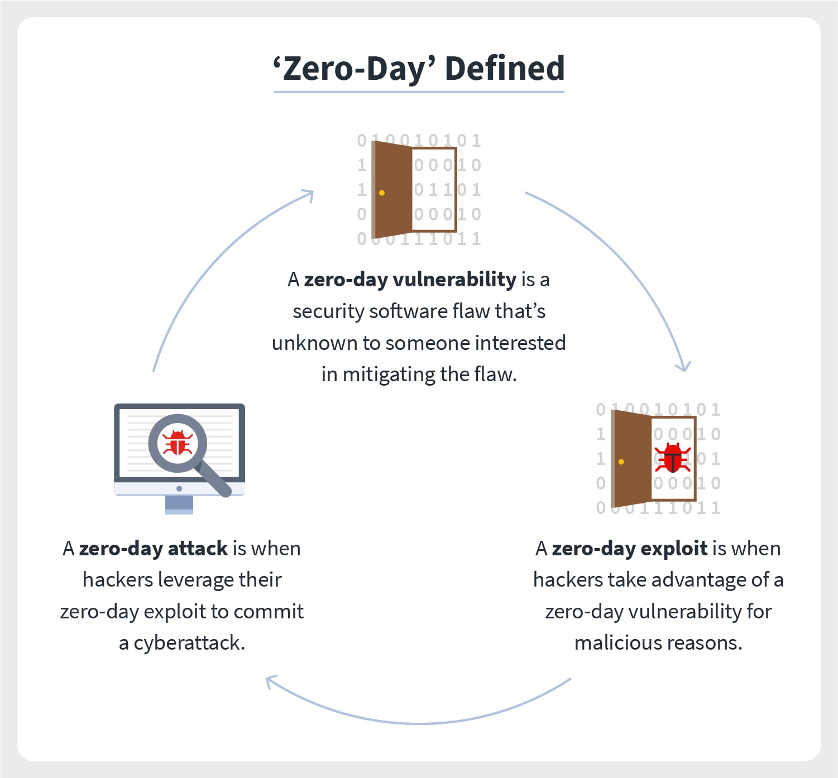
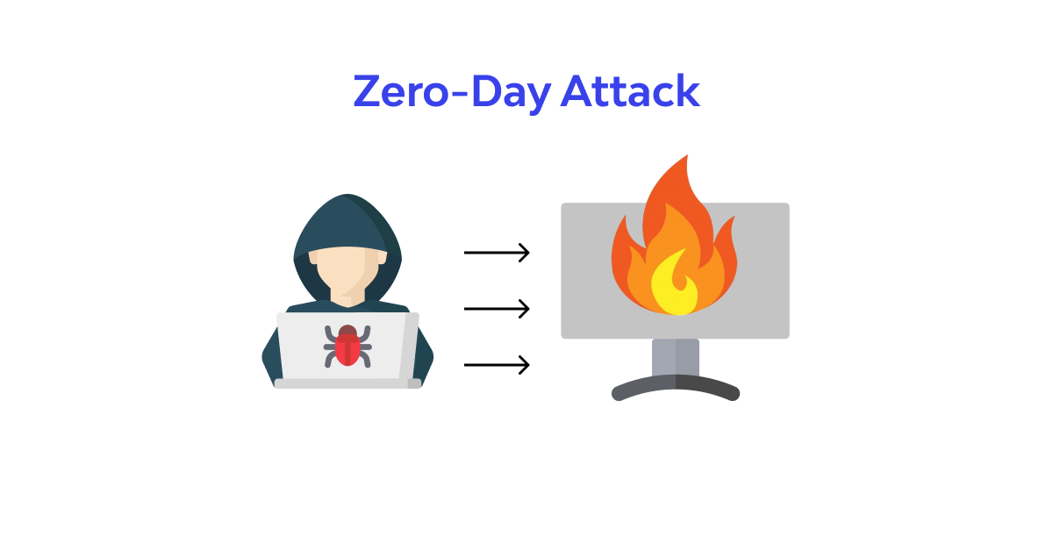
Zero Day Attack

Slide 23
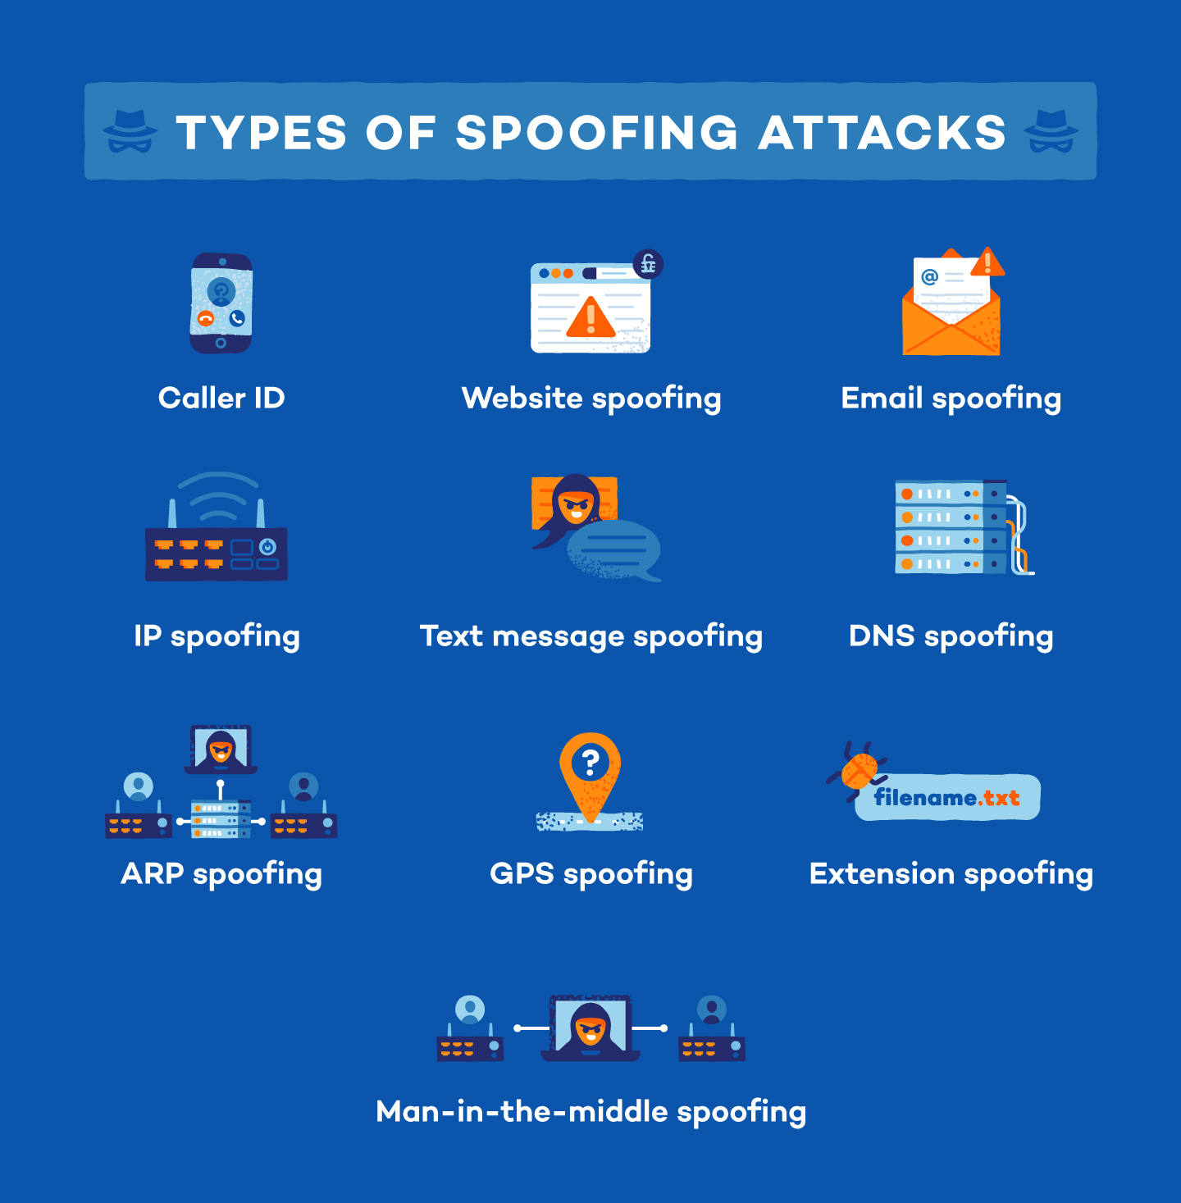
Spoofing
Spoofing, as it pertains to cybersecurity, is when someone or something pretends to be something else in an attempt to gain our confidence, get access to our systems, steal data, steal money, or spread malware. Spoofing attacks come in many forms

Slide 24
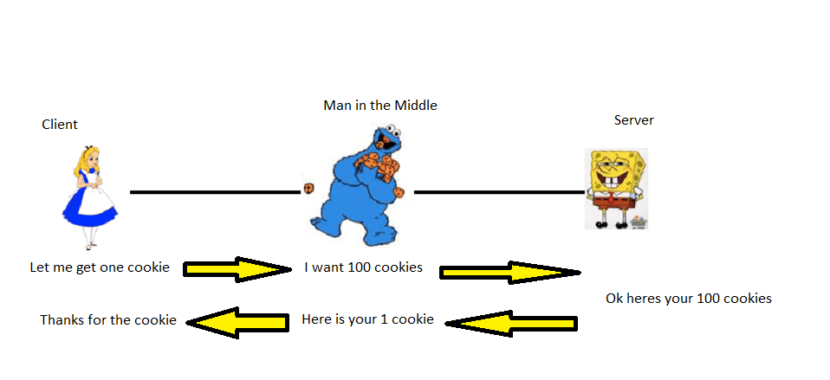
On Path Attack
On-path attackers place themselves between two devices (often a web browser and a web server) and intercept or modify communications between the two. The attackers can then collect information as well as impersonate either of the two.

Slide 25
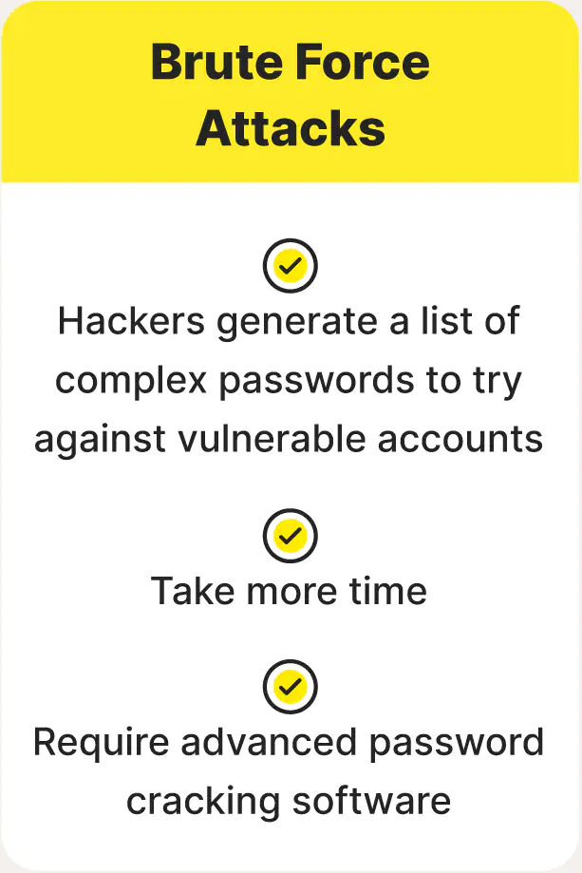
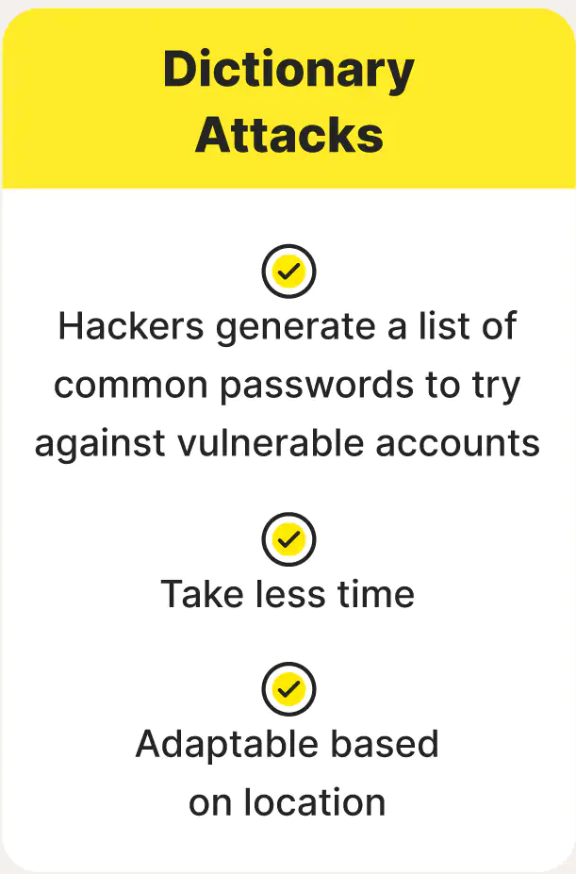
Brute force, Dictionary, & Rainbow Table Attack
A rainbow table attack is a password cracking method that uses a special table (a “rainbow table”) to crack the password hashes in a database.

Slide 26
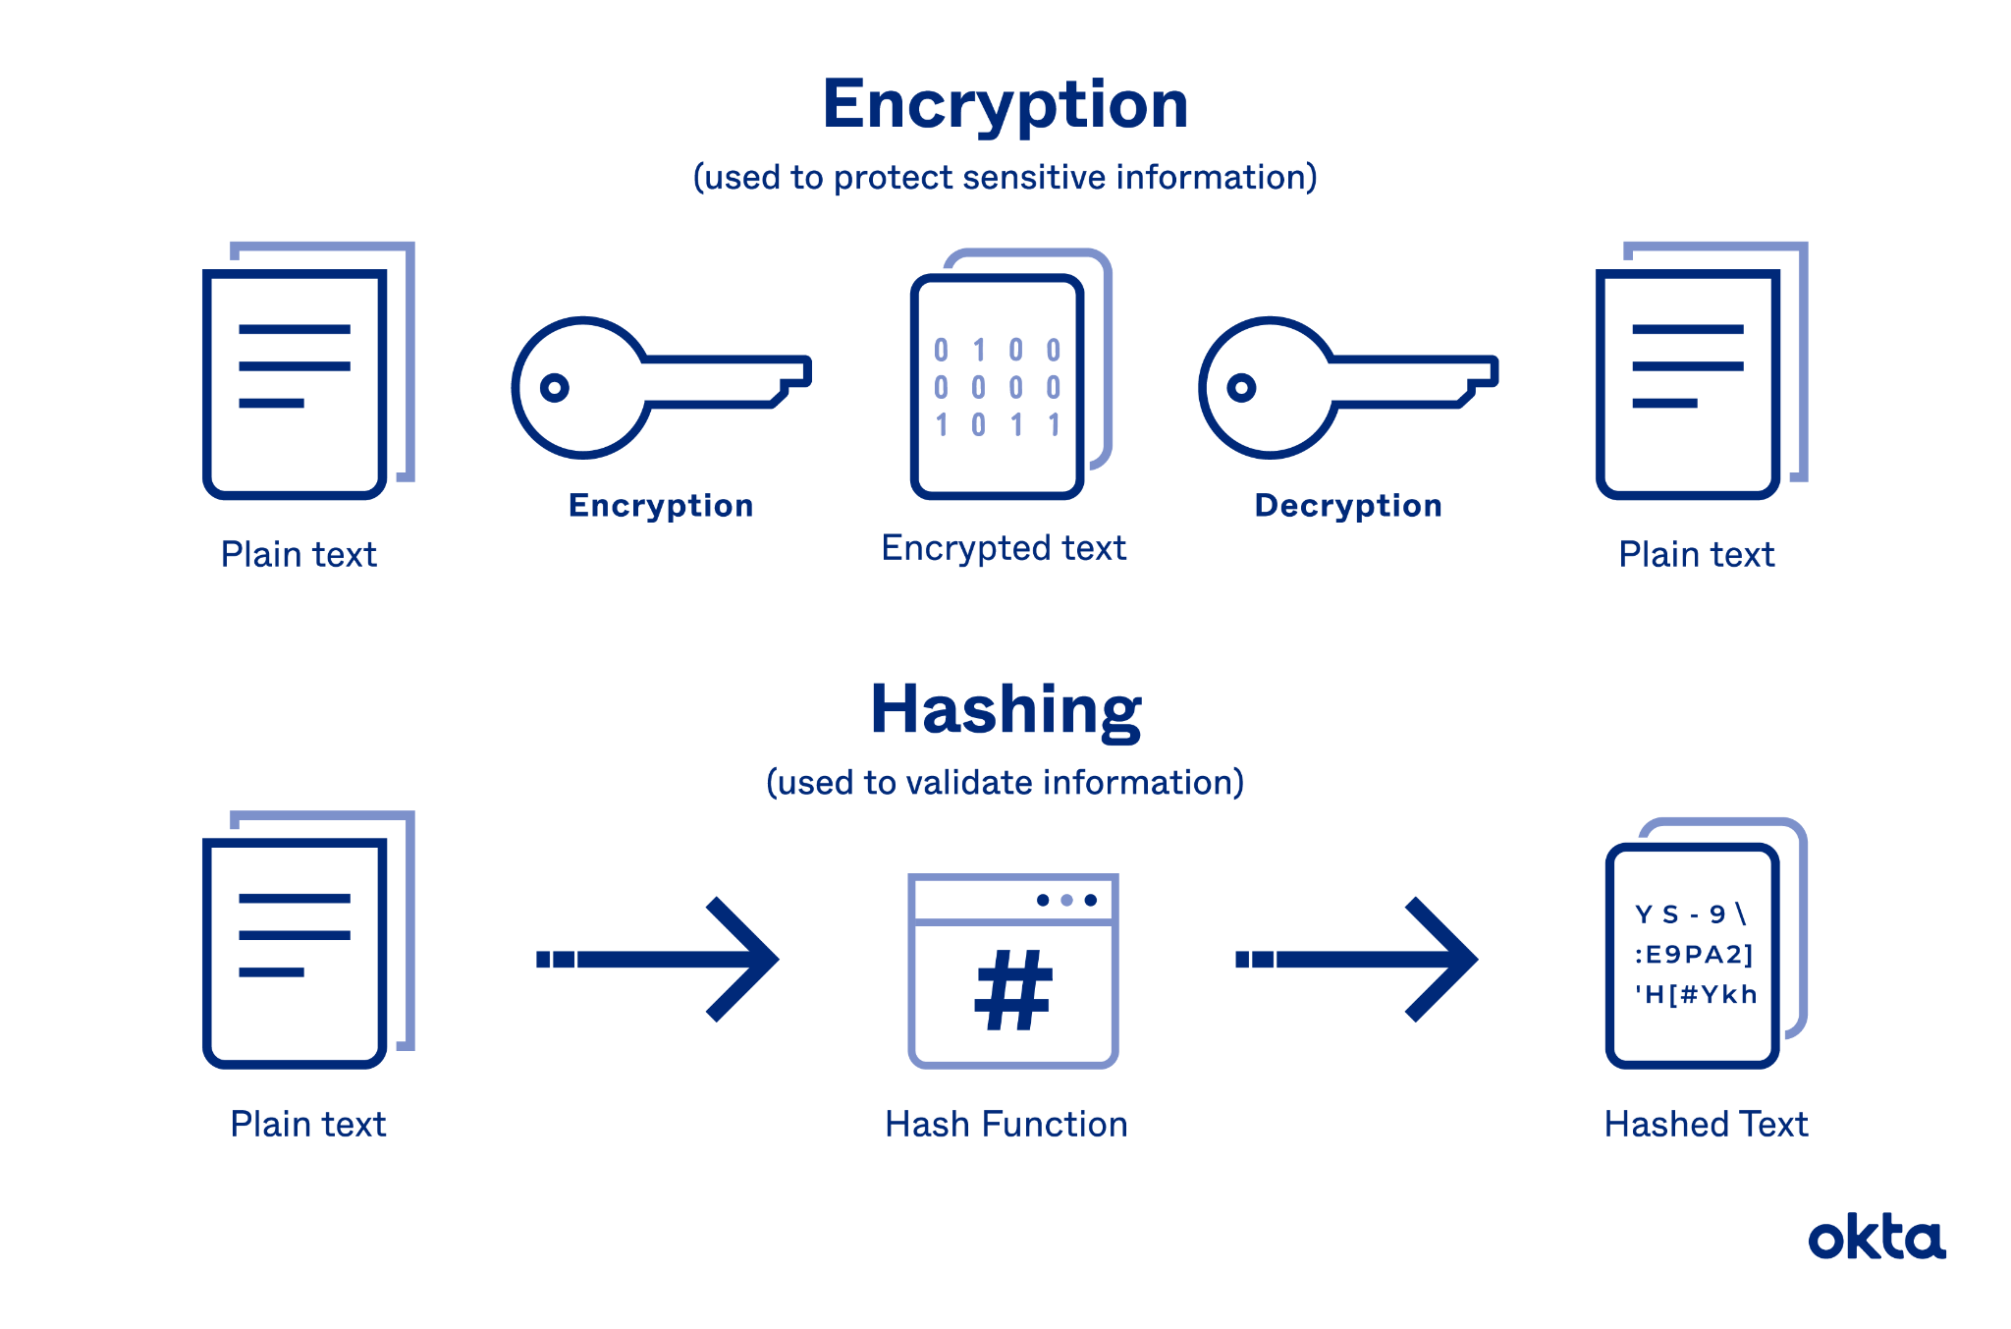
Encryption vs Hashing

Slide 27
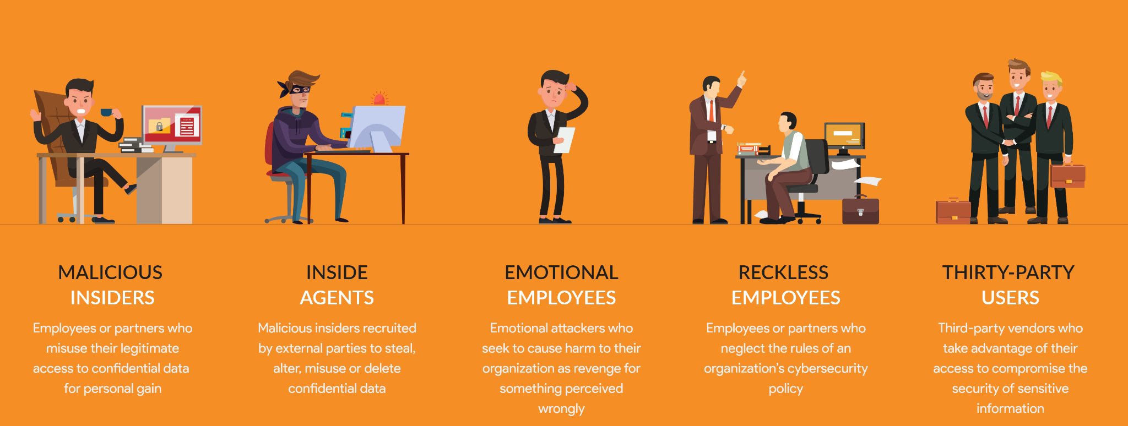
Insider Threat

Slide 28
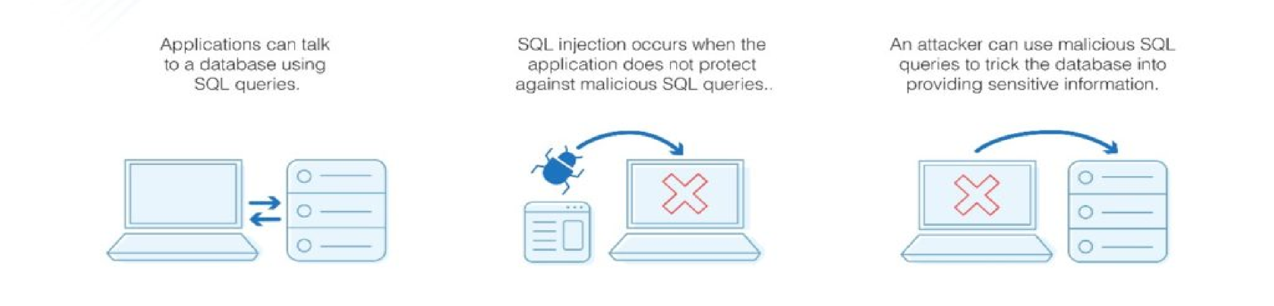
SQL Injection
Simply put: SQL Injections goal is to confuse a databases logic by improper input validation.
Example of SQL Injection looks like this ( 1=1 )

Slide 29
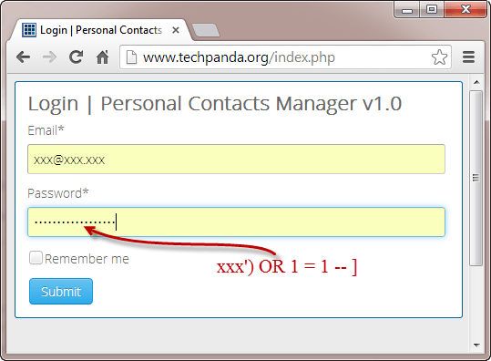
SQL Injection example
A database should be protected from SQL Injections by testing for proper input validations.

Slide 30
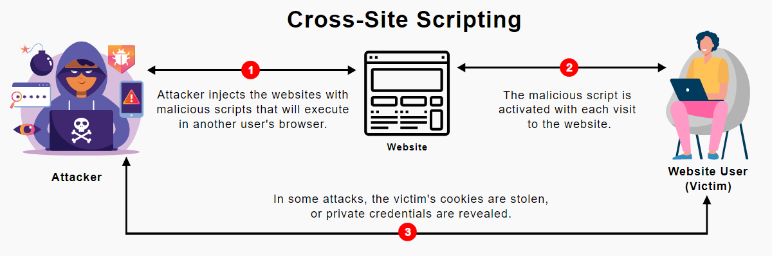
XSS Cross Site Scripting

Slide 31
Vulnerabilities
Non-compliant systems - when a system, device, or computer does not meet the standards set forth by a company, provider or other entity.
Unpatched systems - a computer, device or system that has missing patches to correct known vulnerabilities.
Unprotected systems (missing antivirus/missing firewall)
EOL OSs - End of Life Operating Systems are OS’s that are no longer supported by the manufacturer
Bring your own device (BYOD- A device you are allowed to bring to work and used for either personal, work, or both.
These are things that make either our computers or networks vulnerable to threats and attacks

